Slide 1
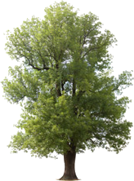
Integrating Crowdsourcing and GIS to Slow the Spread of the Emerald Ash Borer in Minnesota
By Caleb Mackey

Slide 2
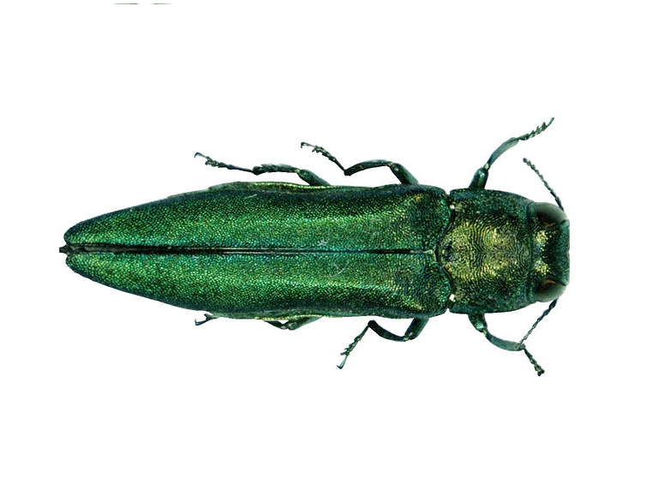
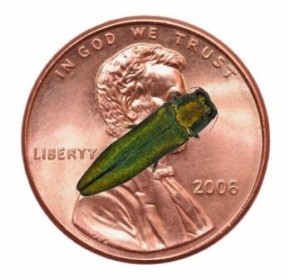
Emerald Ash Borer
Invasive beetle from Asia
1-2 Year life cycle
Larvae eat through the inner tissue of ash trees
Killed hundreds of millions of Ash trees in North America
10mm
2 mm

Slide 3
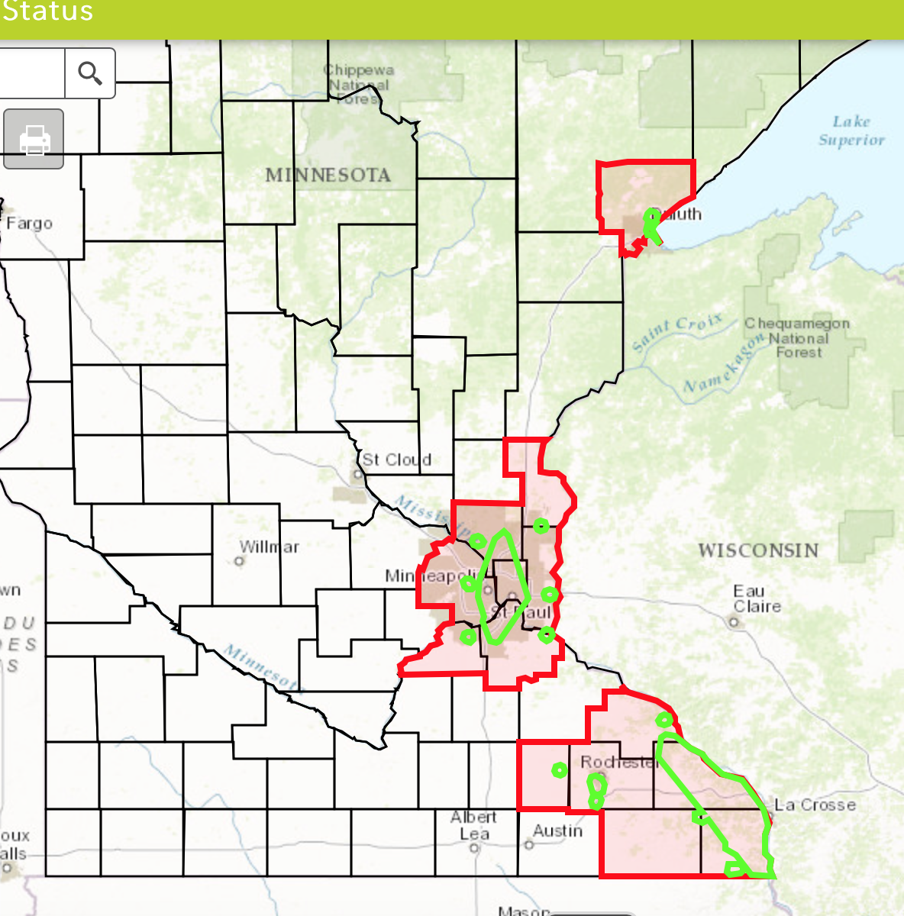
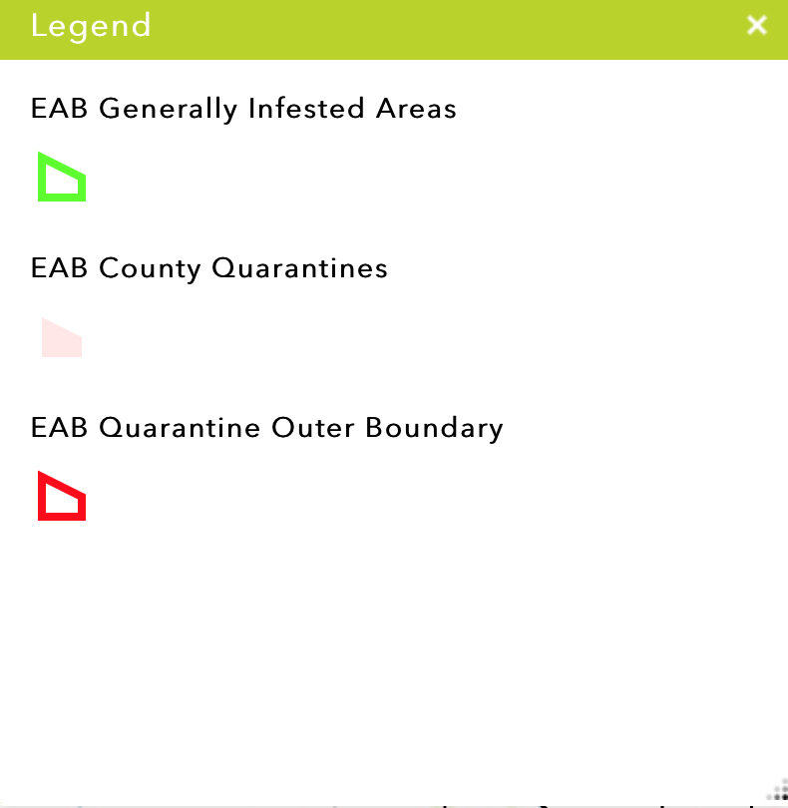
EAB Distribution in Minnesota
Notes:
- St Paul, MN - First reported sightings in 2009
~26,000 ash in public ROW, tens of thousands more in city parks
2015 – EAB city wide coverage went from 55-75%
Up from 3.5% in 2010!

Slide 4
Tracking the EAB in Minnesota
The Minnesota Department of Agriculture (MDA) is the lead agency in Minnesota for monitoring the movements of the EAB.
Purple Prism Traps
Field inspections in high risk areas
Rely on visual cues of EAB Attacks

Slide 5
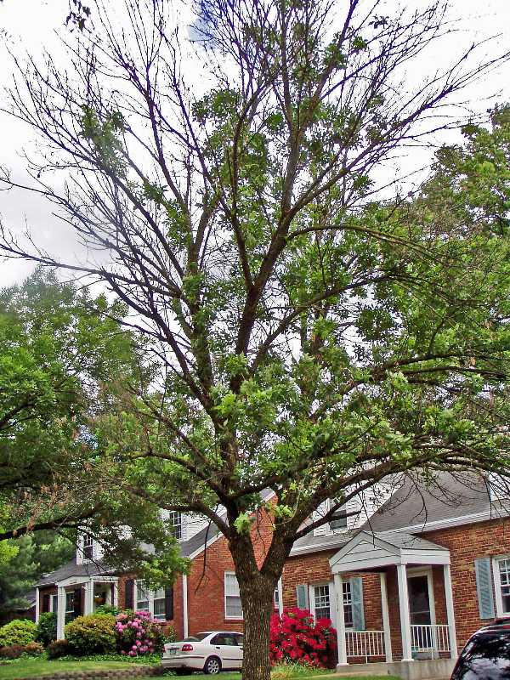

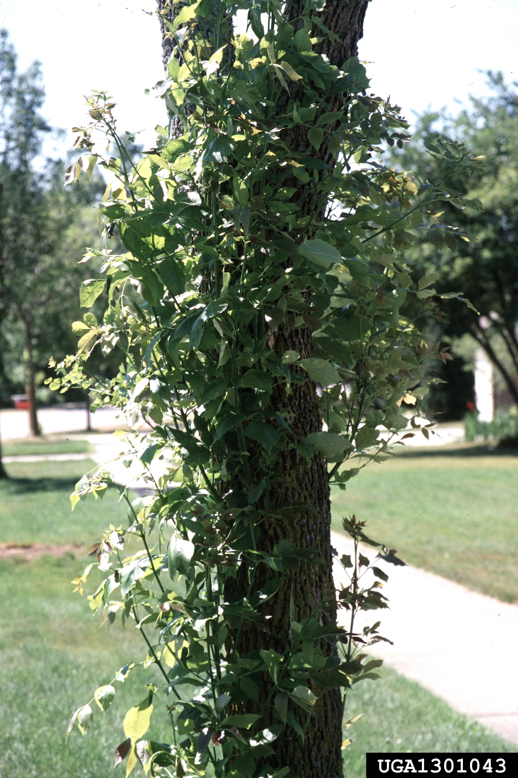
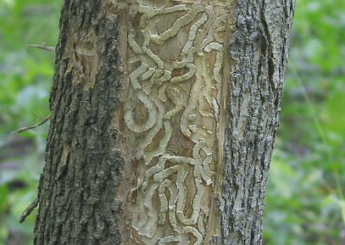
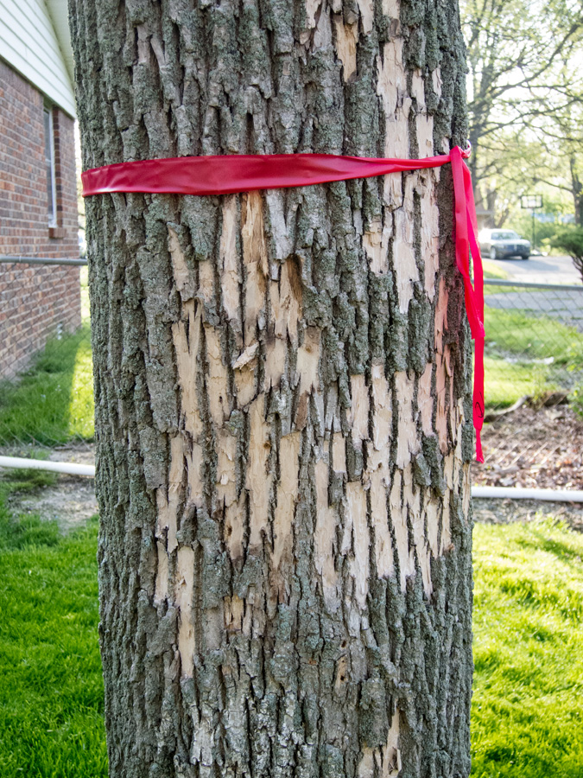
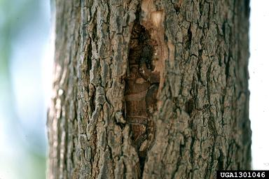
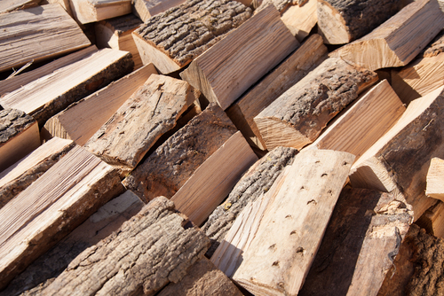
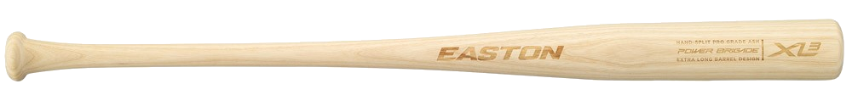
Fraxinus Spp. (Ash Trees)
Notes:
Ash trees (Fraxinus spp.) are an economically important source of wood in the United States
ADVANCE
with uses in furniture, firewood, and even baseball bats.
EAB are able to spread rapidly and continue to attack ash trees because there is no control on their population.
Woodpeckers and a few types of wasps will prey on them, but not enough to make a significant impact against their numbers.
Also, ash trees have not been able to develop a resistance to the EAB because of how fast they have spread and how quickly they can kill a tree.
The larvae bore through the vascular tissue of the trees (phloem), which cuts off the nutrient supply from the roots to upper portions of the tree. An infected tree will die within 2-4 years after the initial infestation, depending on how many EAB are living inside.
ADVANCE
There are warning signs for an Ash tree in distress. These include a thinning crown as nutrients are cut off from the boring larvae. This process begins with the top 1/3 of the canopy and continues until the tree is bare.
ADVANCE
Epicormic shoots grow from the roots and the tree trunk with leaves much larger than normal. This isn’t always a sign of EAB on it’s own, trees under stress will stop repressing the gene that causes epicormics shoots, but when combined with one or more other symptoms it almost always means EAB infection.
ADVANCE
The bark can split due to callous tissue formation, much like a scar on the tree. When these splits occur they expose the larvae gallery.
ADVANCE
And you can see the larvae gallery shows unique s-patterns within the vascular tissue of the tree, filled with sawdust and larvae excrement.
ADVANCE
And finally there may be damage to the bark, known as bark flecking, due to increased woodpecker and rodent activity attempting to get at the larvae under the tree bark.

Slide 6
Quarantines and Mitigation
Quarantines issued in response to new sightings
No firewood can be moved outside of quarantine
When a county is quarantined, the MDA will begin mitigation planning
Bio controls (wasps and woodpeckers)
Insecticides

Slide 7
Challenges
Checking all the traps?

Slide 8
Motivation
Early Detection is extremely important to slowing their spread!

Slide 9
VGI – “Humans as Sensors”
Defined by Michael Goodchild as using technology to “create, assemble, and disseminate geographic information provided voluntarily by individuals”
The MDA is encouraging VGI to help with early detection
Web GIS can be used to facilitate VGI and store the GIS data
Notes:
How can we help with early detection? VGI!

Slide 10
How to Promote VGI for EAB Early Detection?
My Solution: Develop a mobile application
Target Platforms?
Android - ~71% market share
iOS - ~23% market share
Why Native Application over Web application?
Better performance
Full access to device capabilities
Push notifications, device sensors, local storage
Does not require having a web server (web app must be hosted from somewhere)

Slide 11
How to expose GIS Functionality in Native Apps?
In order to leverage the full capabilities of the ArcGIS platform in a native mobile application, the ArcGIS Runtime Software Development Kits (SDKs) are required.

Slide 12
Goals of Application
Allow user to report sighting
Provide a simple identification guide for EAB and Ash trees
Incorporate a map view where the user can view existing sightings and MDA EAB GIS data
Automatically generate an email to send to the MDA’s “Arrest The Pest” email account
Send push notifications to all users when new sightings are reported
Add authentication so the MDA can login to edit data

Slide 13
Application Development
iOS – App is currently 70% complete. Built with Apple’s Swift programming language and the Xcode Integrated Development Environment (IDE)
ArcGIS Runtime SDK for iOS was added to the project via CocoaPods
Android – Currently 40% complete. Built with the Java programming language and Android Studio IDE.
ArcGIS Runtime SDK was added to the project using a maven bintray
Both apps required special user permissions:
Camera/media access
GPS/location services
Internet access
In Android, permissions to use OpenGL for GPU acceleration had to be explicitly added.

Slide 14
preliminary results
The mobile application can be used to effectively report new sightings.
If many people use the app and are able to report sightings, it will help the MDA find sightings in new areas.
If a new infestation is caught early enough, then maybe the MDA can act quickly to gain control over the local population before it spreads.
The biggest challenge will be getting people to use the app.
How to get the word out?
Social Media?
How to educate people that this is an important issue and they can help?

Slide 15
conclusion
Through this research, I have successfully built an iOS and Android app to report EAB sightings.
The applications alert the appropriate authority (MDA and DNR)
The app will assist in early detection so the MDA can institute quarantines
With the ability to report sightings in real time, it will be helpful in reducing the spread of the EAB in Minnesota

Slide 16
Demo

Slide 17
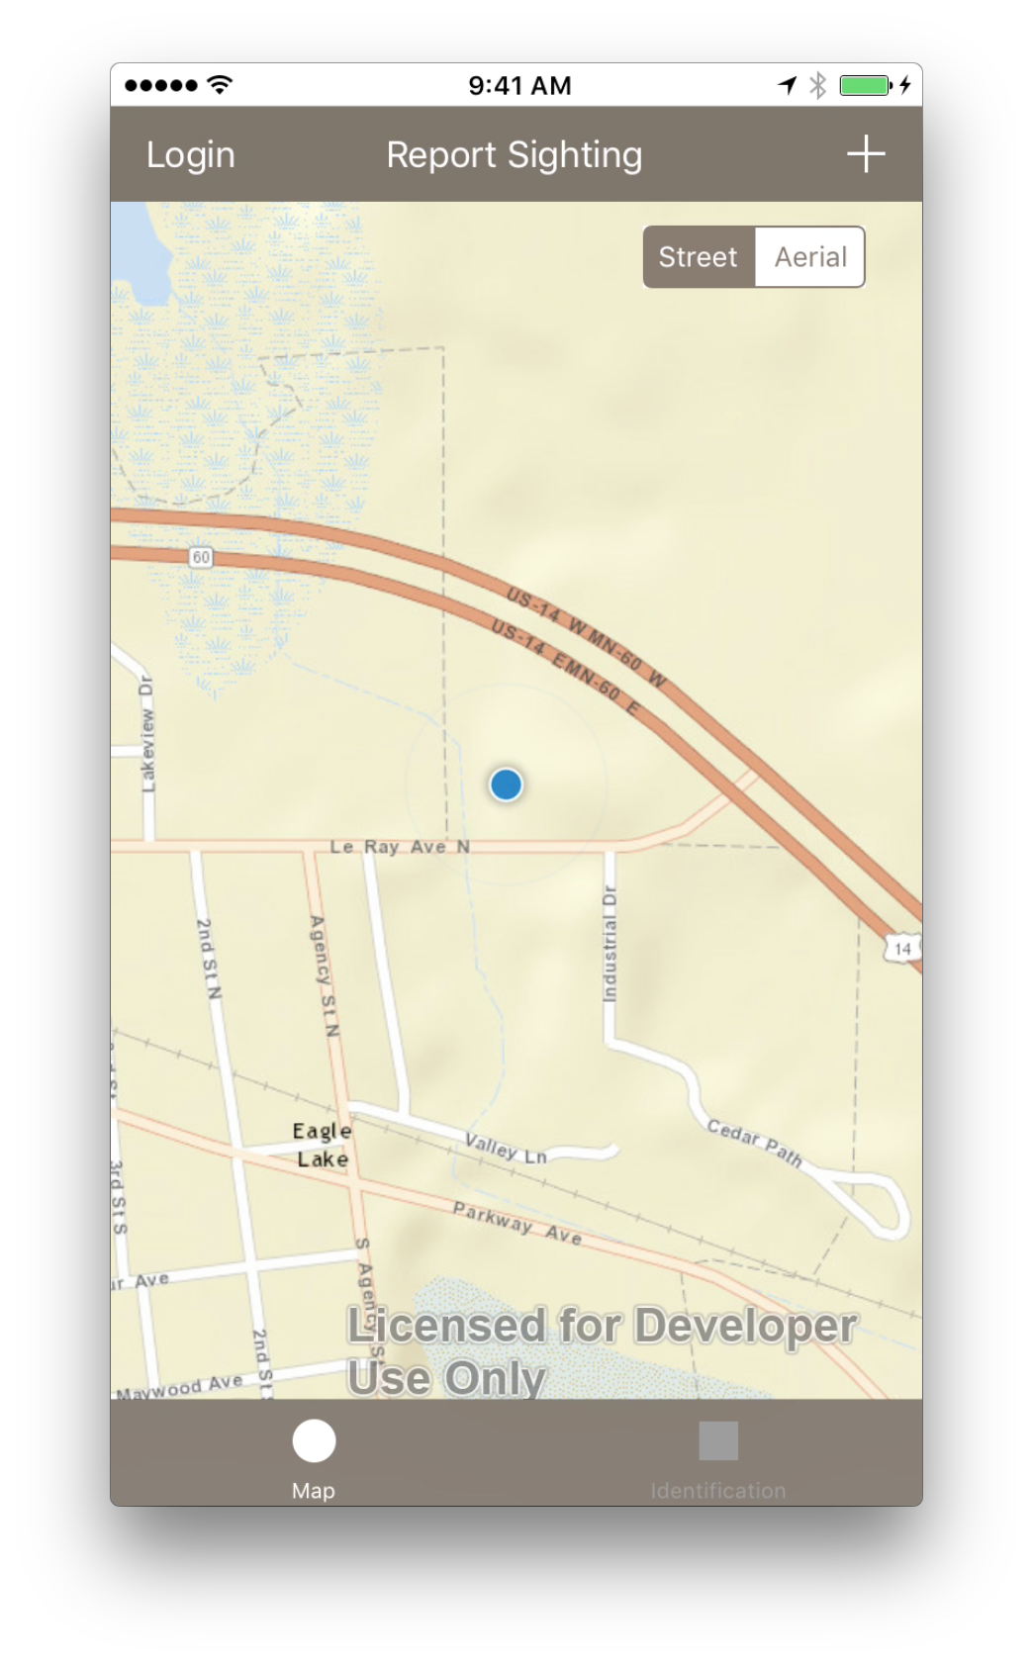
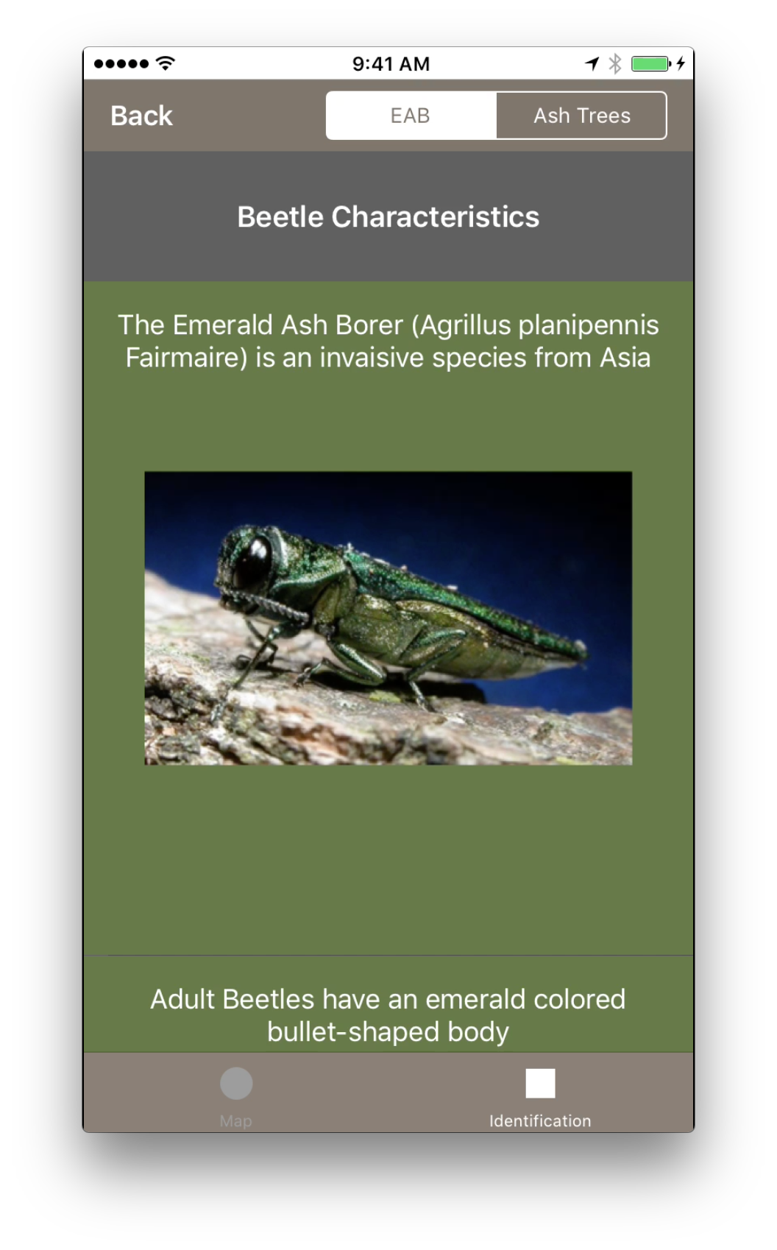
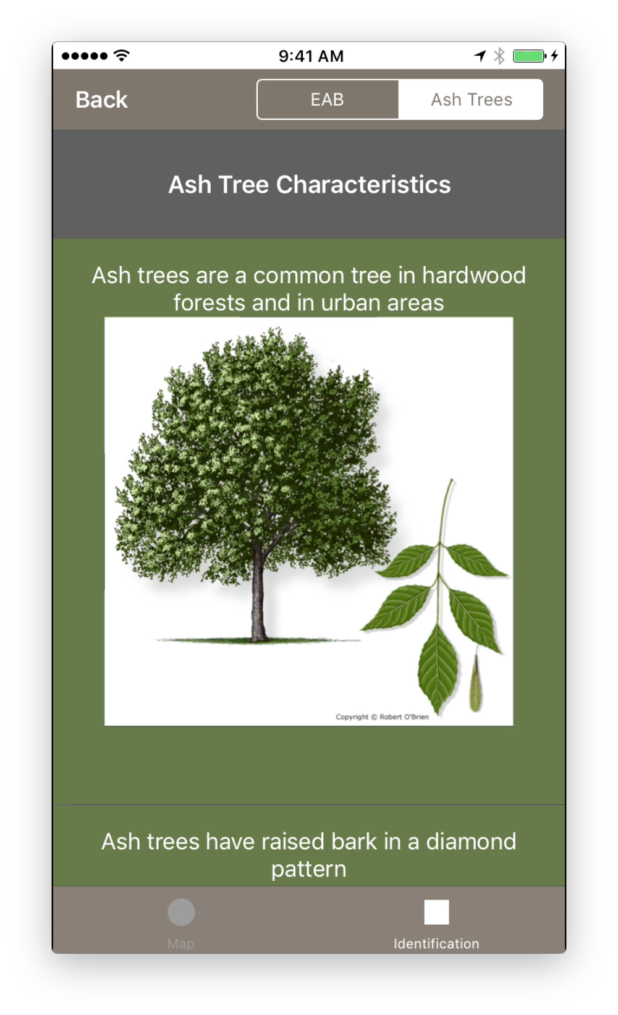

Slide 18
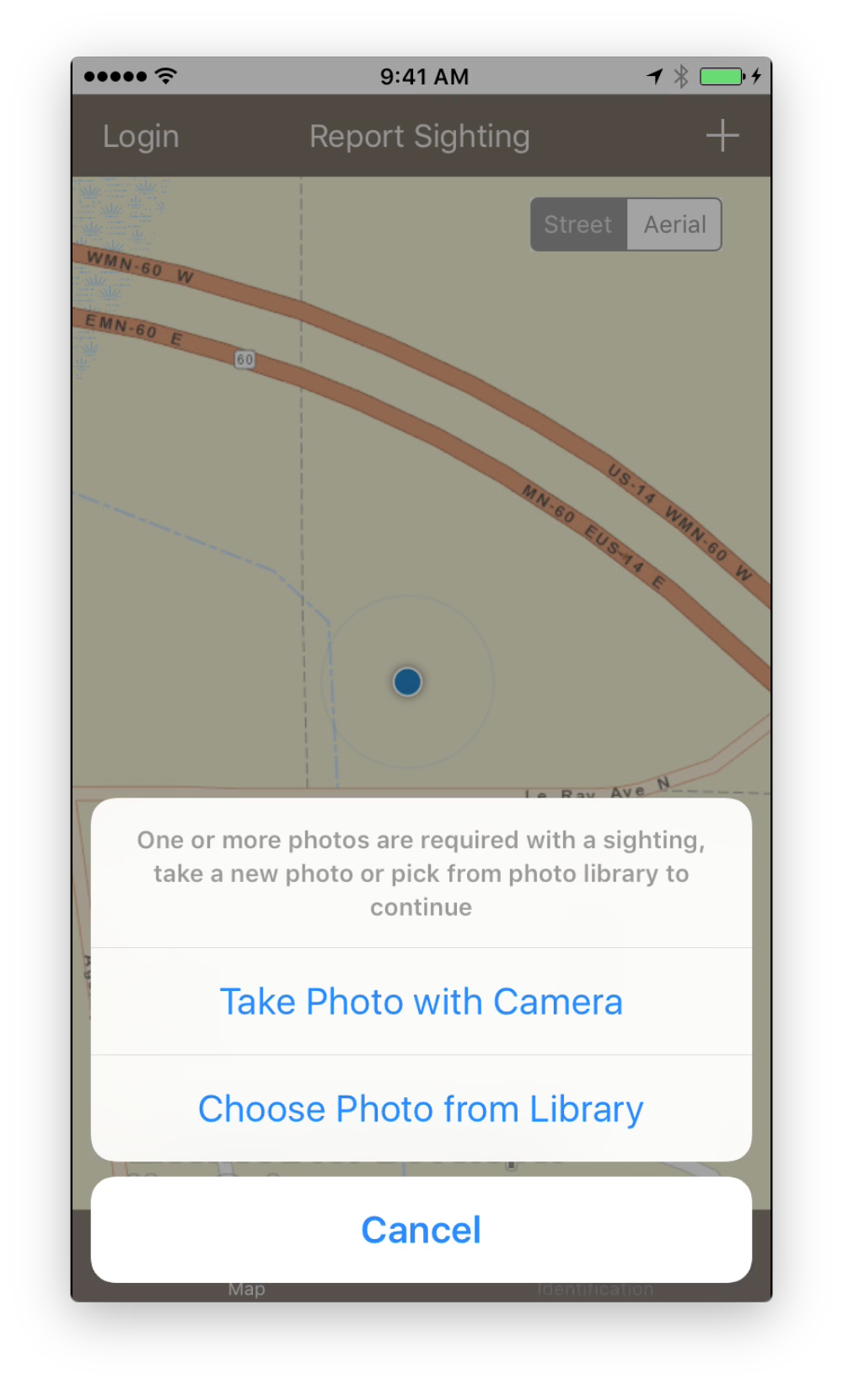
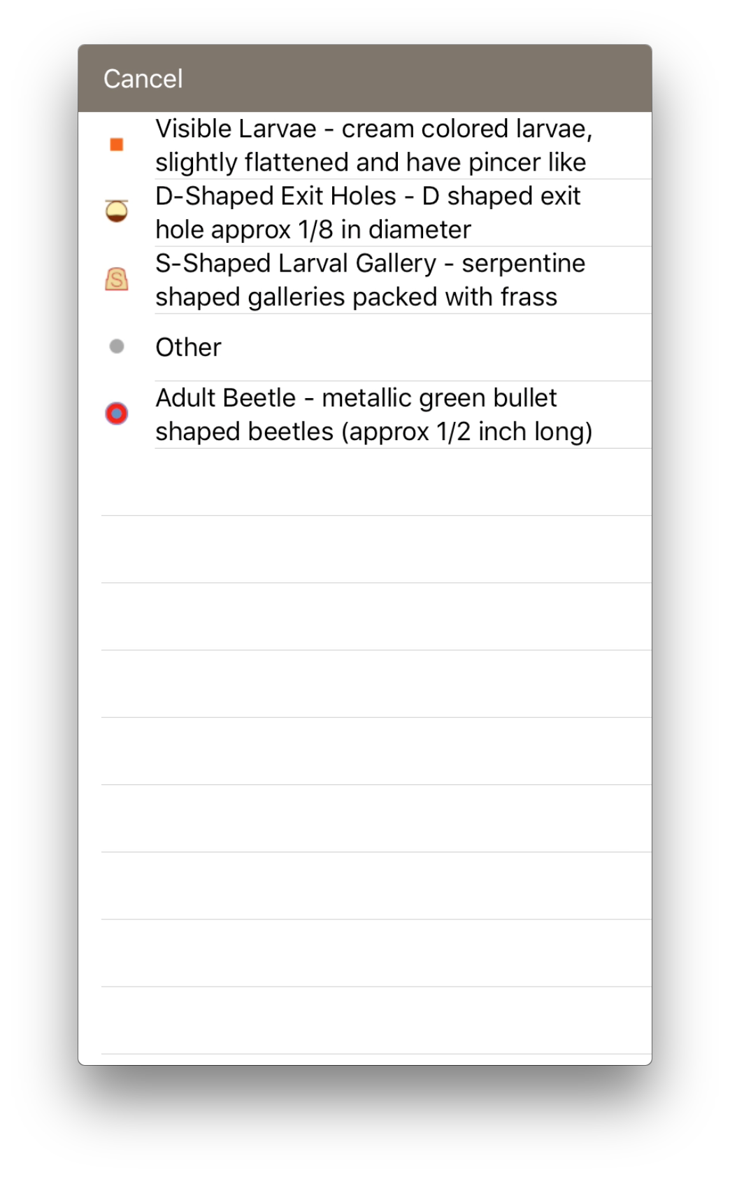
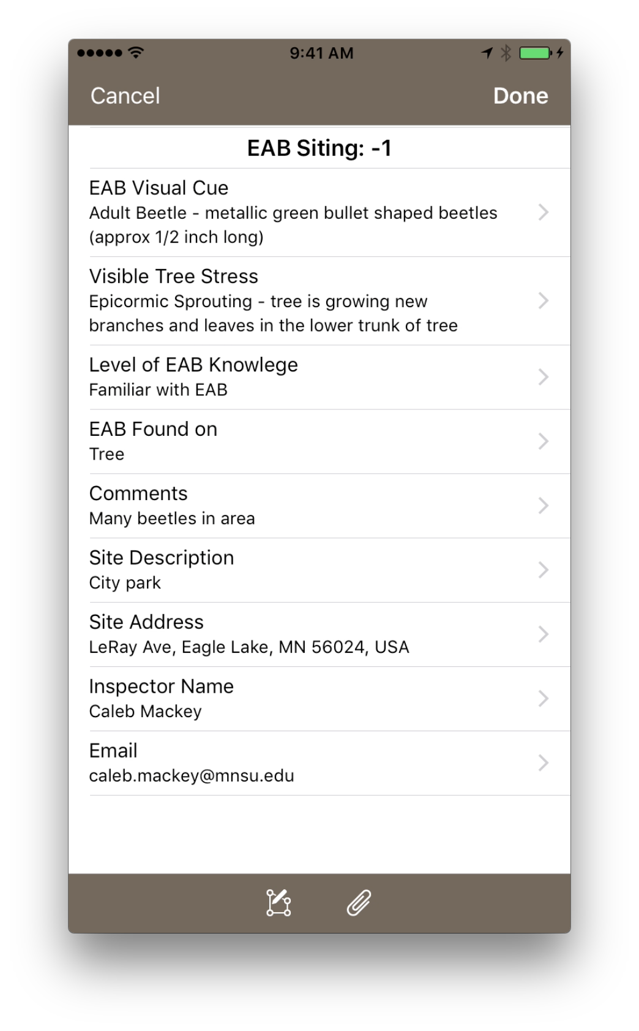

Slide 19
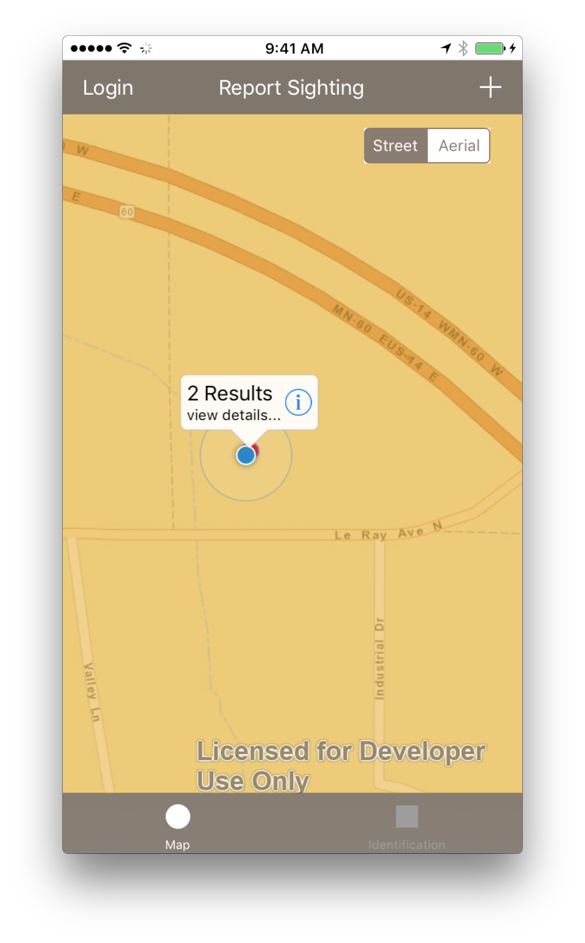
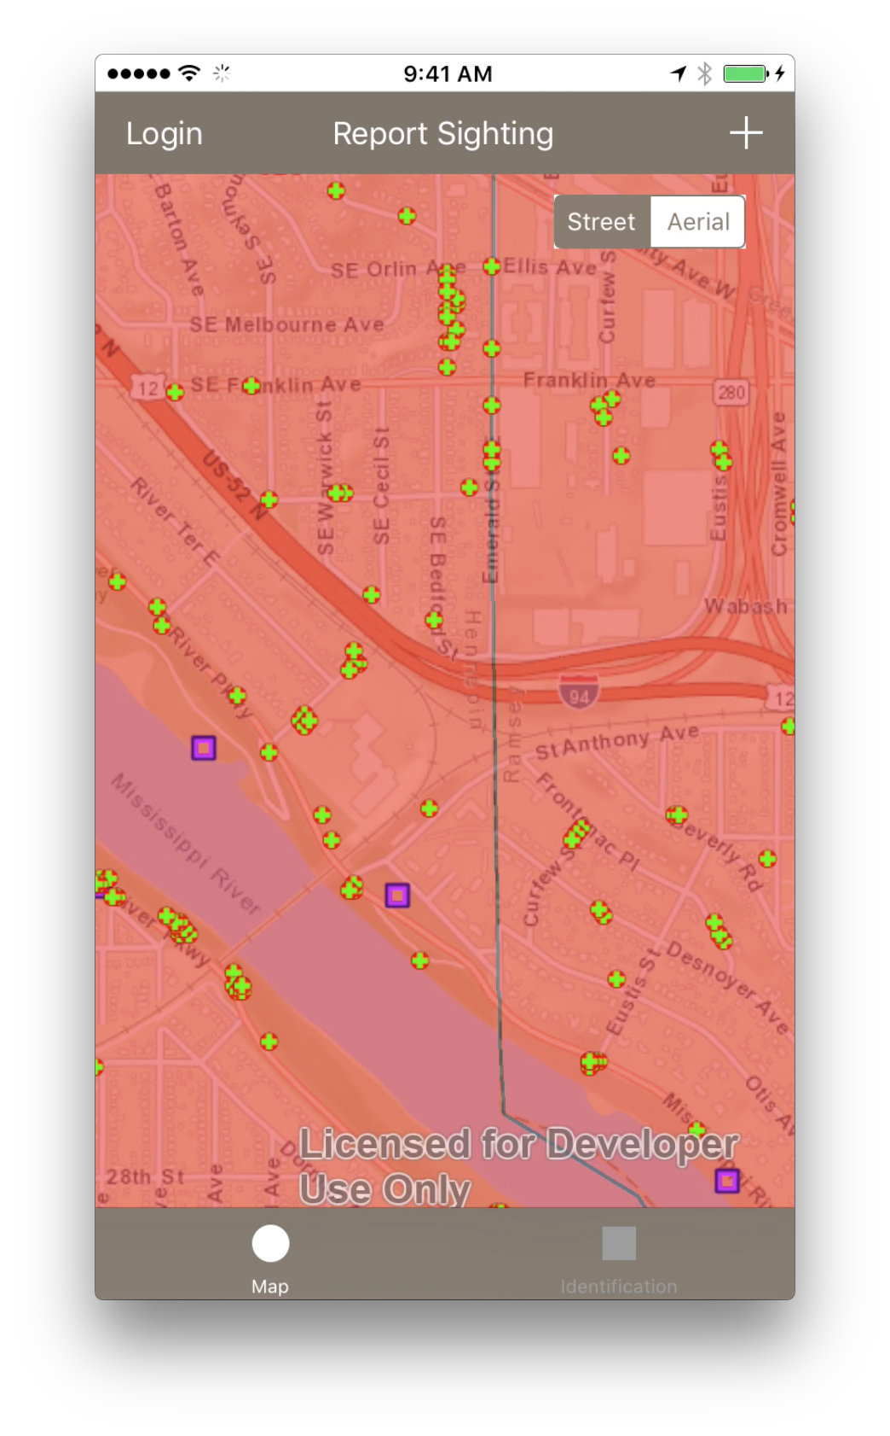
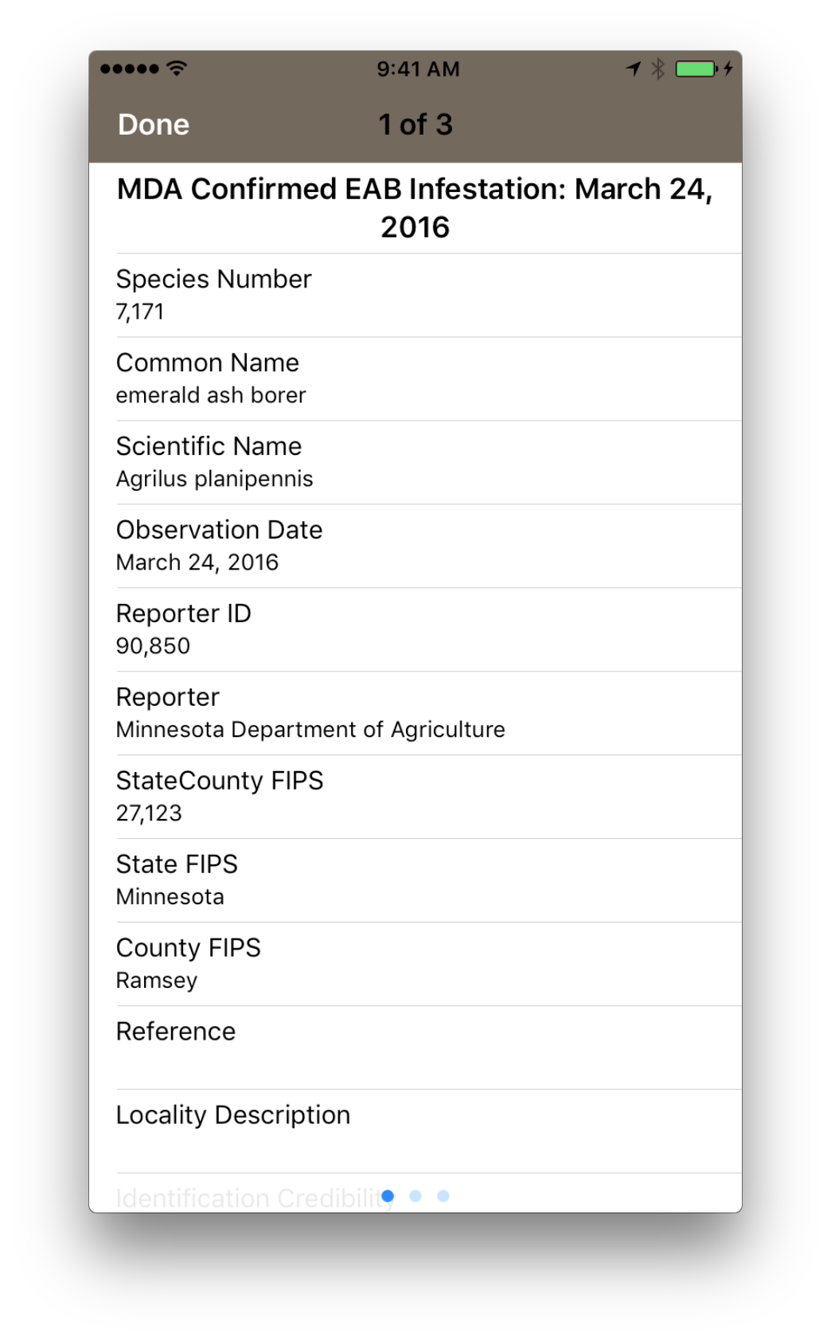

Slide 20
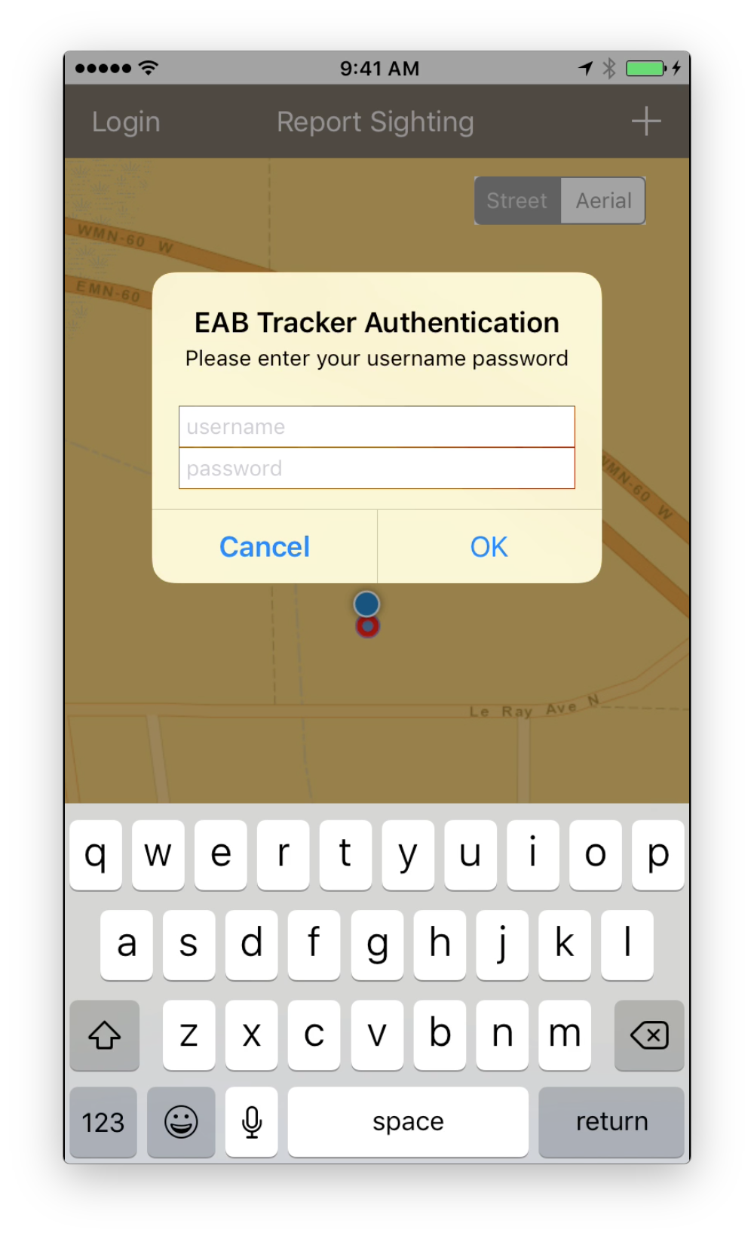
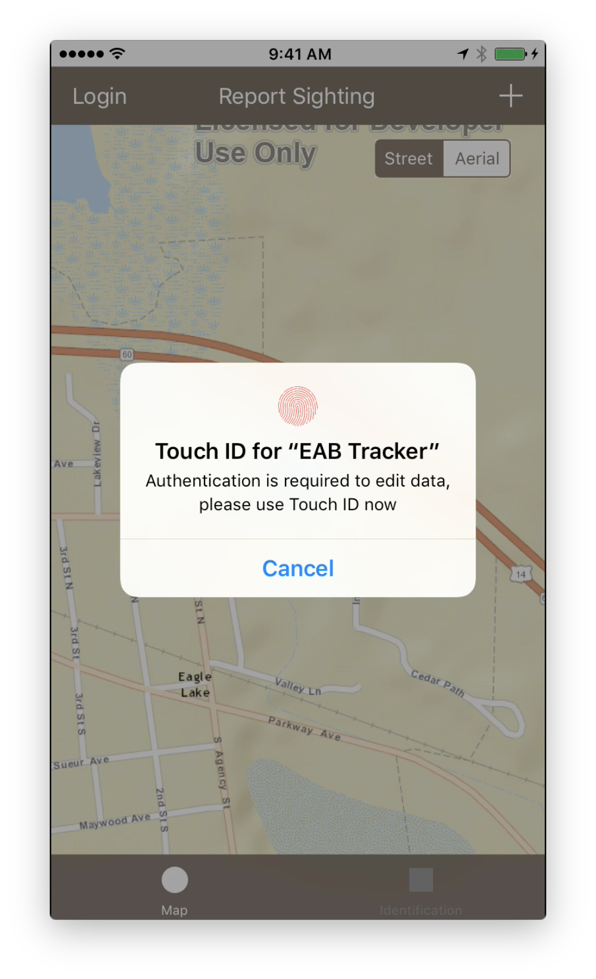
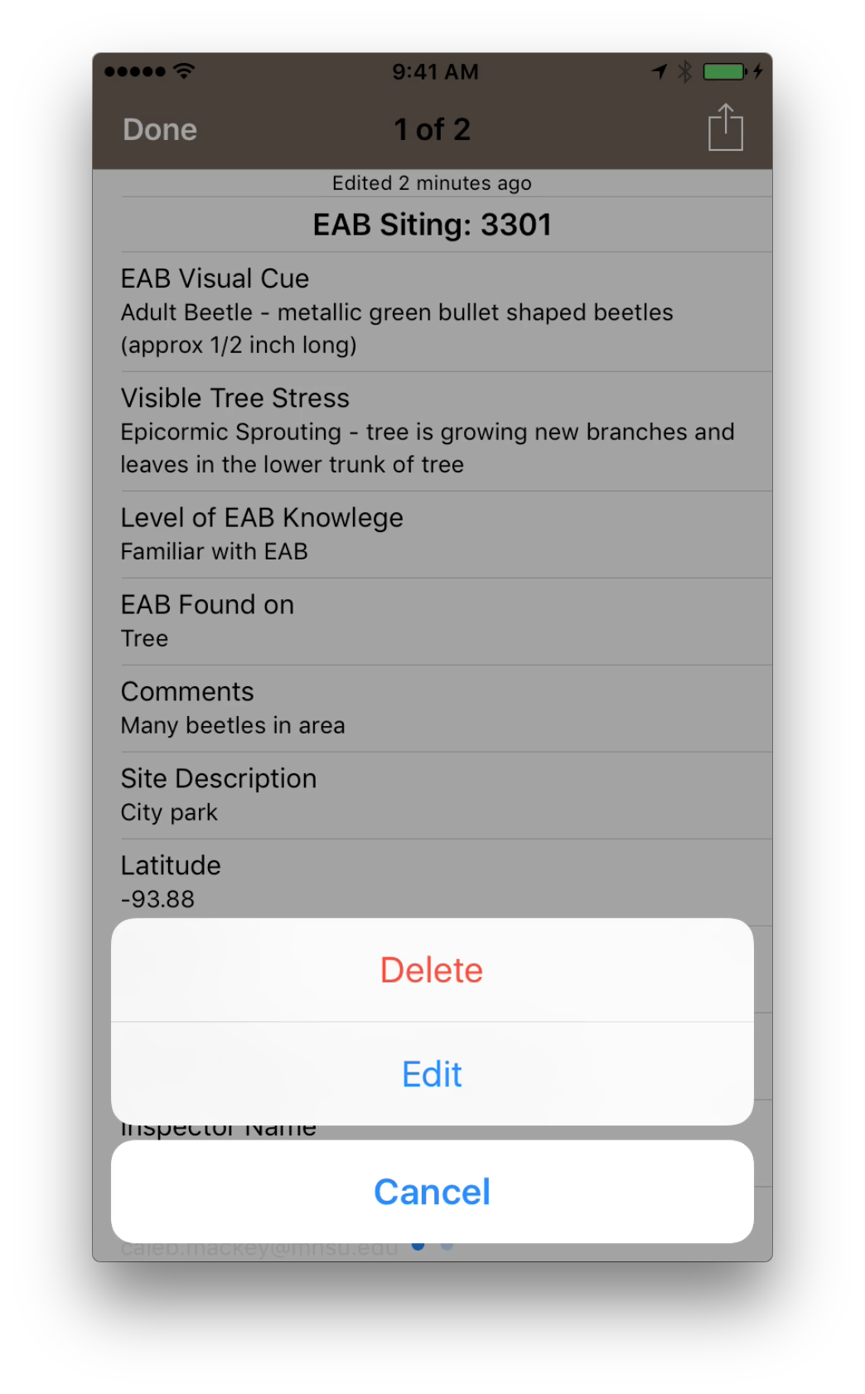

Slide 21
Thank you for your attention!
Questions?

